Slide 1
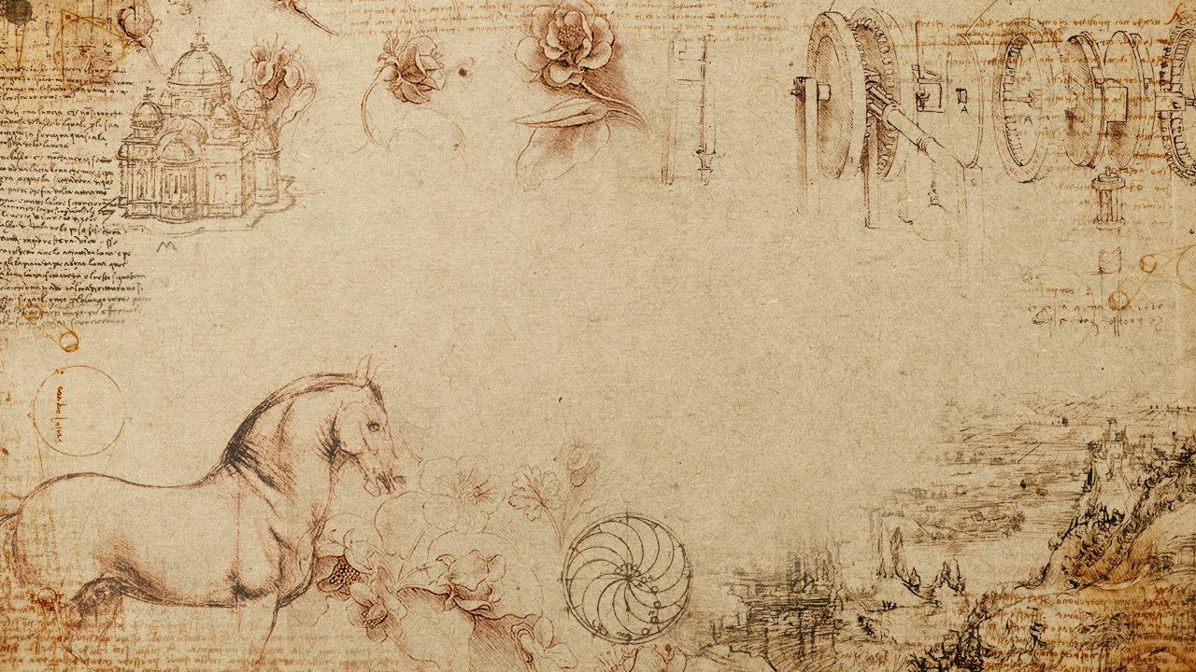
Analysis on Britain’s Early Modern Social Network
- Team 6 -
Josh Chen
Alex Lu
Mira Stefanova
Andy You

Slide 2

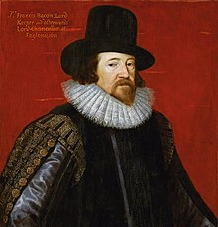
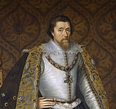
Data Exploration
Six Degrees of Francis Bacon is a dataset of Britain’s early modern social network
Francis Bacon
Discovery
People: 15801
Edges: 171409
Female Ratio: 20%
Avg. years of relation: 42.5
Avg. length of life: 69.2
Year range: 1389 – 1722
Relationship Type: Met
Start year: 1587
End year: 1625
Confidence: 71
{
Prefix: King
Suffix: VI and I
Birth year: 1566
Death year: 1625
Gender: Male
Historical significance: King of Scotland, England, and Ireland
James IV and I

Slide 3
Data Preparation
Deleted values with confidence < 20 and abnormal entries
Identified Kings and Queens with sufficient network data by historical significance
11 Kings, 20 Queens
Grouped individuals by social
status through filtering suffix, title,
and historical significance
Status/Title | %
No title | 70.9
Regular (Doctor) | 13.9
Religious | 13.8
Titled (Duke) | 0.9
Royal | 0.5

Slide 4
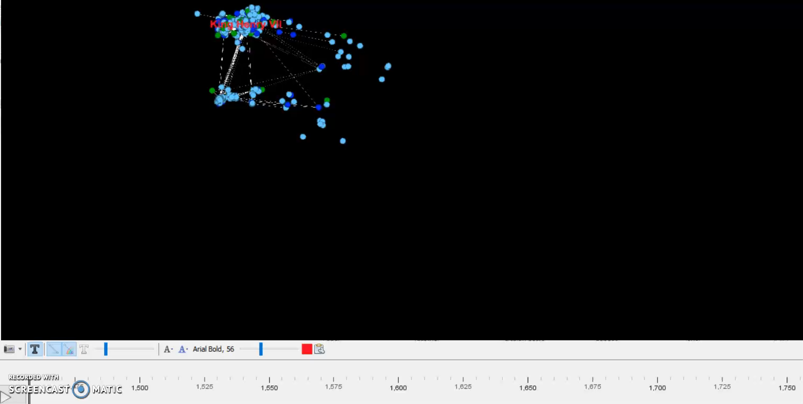

Transformation of Social Network over time

Slide 5
Shift in Network Dynamic - Death of King/Queen
Motivation
King/Queen are most influential individuals in the network
Their death changes the network of the royal families and affiliated individuals dramatically
Approach
Filter connections 5 years before and after a king/queen’s death
Identify neighbor of each king/queen and compute their ecntralities
Use the first year as the base centrality measure to calculate change

Slide 6
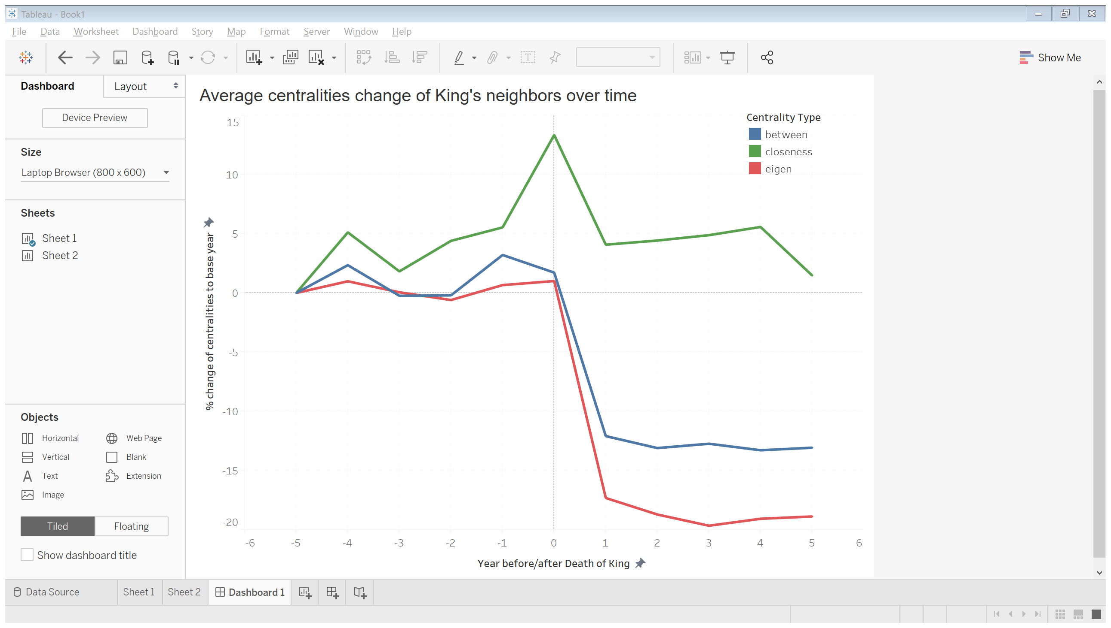
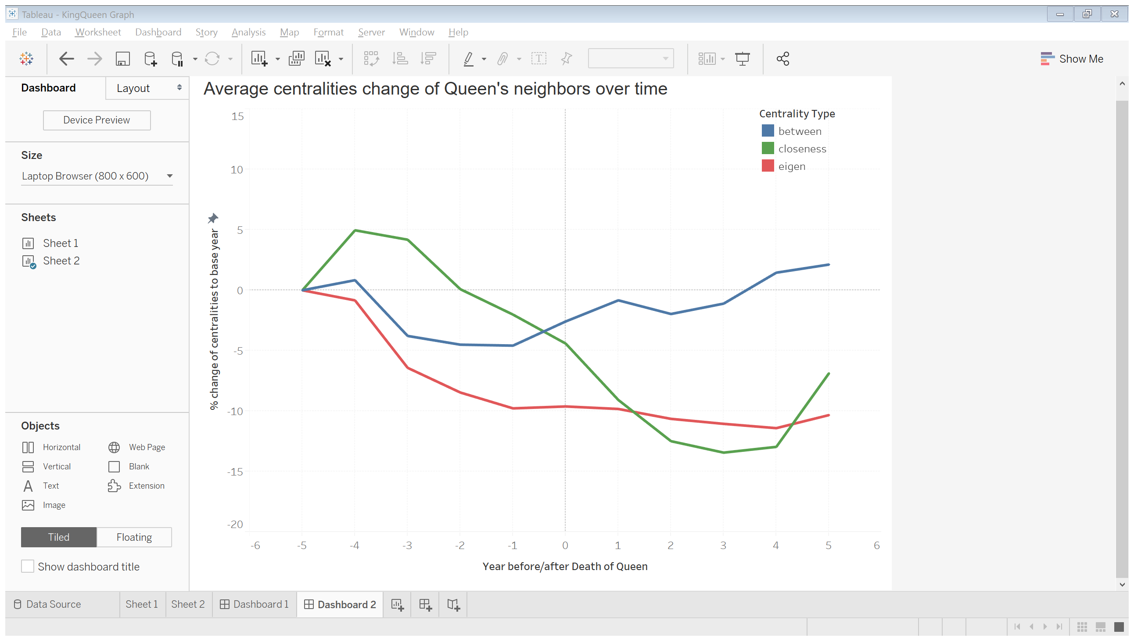
Shift in Network Dynamic - Death of King/Queen
King
Queen
The network impact of a king’s death is significantly greater than that of a queen
Closeness and eigenvector centralities drop significantly after the death of king and show no signs of recovering within 5 years

Slide 7
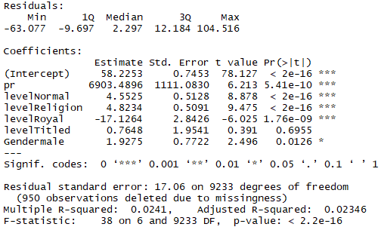
Regression Analysis on Life Expectancy
$$life length=page rank+factor\left(social status\right) +factor(gender)$$
Individuals with certain titles lived longer than those without any title.
Royal members lived much shorter than other people - might because by unnatural death in war.

Slide 8
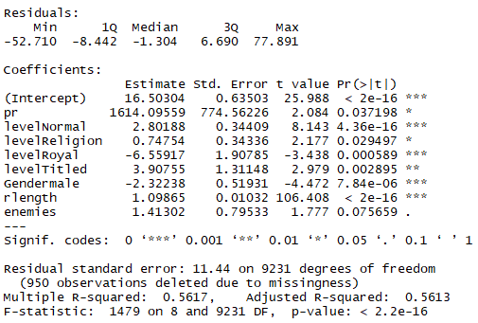
Regression Analysis on Life Expectancy
$$life length=page rank+factor\left(social status\right) +factor\left(gender\right)$$
$$+ relation length+enemy$$
Added the number of enemies and the mean relationship length of each individual
The sign of gender coefficient changes
The number of enemies has a positive coefficient

Slide 9
Thanks!
Any questions?

Slide 10
SlidesCarnival icons are editable shapes.
This means that you can:
Resize them without losing quality.
Change fill color and opacity.
Isn’t that nice? :)
Examples:

